Slide 1
Chapter 3-Logical Events/Knowledge based Agent

Slide 2
Knowledge-Based Agent in Artificial intelligence
An intelligent agent needs knowledge about the real world for taking decisions and reasoning to act efficiently.
Knowledge-based agents are those agents who have the capability of maintaining an internal state of knowledge, reason over that knowledge, update their knowledge after observations and take actions.
These agents can represent the world with some formal representation and act intelligently.

Slide 3
Knowledge based Agent Components and Operations
Knowledge-based agents are composed :
Knowledge-base –Set of Sentences-called Background Knowledge
Axiom-When the sentence is taken as being given without being derived from other sentences
Inference system-Derives New Sentences from Old
Operations by Agent
Tell
Ask
Perform

Slide 4
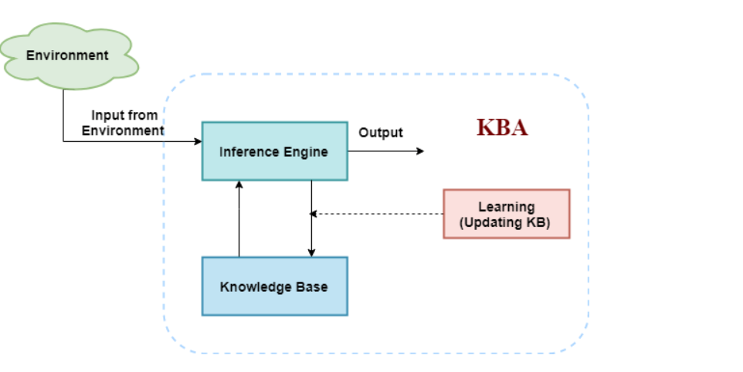

Slide 5
Why use a knowledge base?
Knowledge-base is required for updating knowledge for an agent to learn with experiences and take action as per the knowledge.

Slide 6
Inference system
Inference means deriving new sentences from old. Inference system allows us to add a new sentence to the knowledge base. A sentence is a proposition about the world. Inference system applies logical rules to the KB to deduce new information.

Slide 7
Operations Performed by KBA
Following are three operations which are performed by KBA in order to show the intelligent behavior:
TELL: This operation tells the knowledge base what it perceives from the environment.
ASK: This operation asks the knowledge base what action it should perform.
Perform: It performs the selected action.

Slide 8
generic knowledge-based agent:
function KB-AGENT(percept):
persistent: KB, a knowledge base
t, a counter, initially 0, indicating time
TELL(KB, MAKE-PERCEPT-SENTENCE(percept, t))
Action = ASK(KB, MAKE-ACTION-QUERY(t))
TELL(KB, MAKE-ACTION-SENTENCE(action, t))
t = t + 1
return action

Slide 9
MAKE-PERCEPT-SENTENCE-Constructs a sentence asserting that the agent perceived the given percept at given time
MAKE-ACTION-QUERY-constructs a sentence that asks what action should be done at the current time.
MAKE-ACTION-SENTENCE-constructs a sentence asserting that chosen action was executed.

Slide 10
Knowledge Based Agent
The knowledge-based agent takes percept as input and returns an action as output.
The agent maintains the knowledge base, KB, and it initially has some background knowledge of the real world.
It also has a counter to indicate the time for the whole process, and this counter is initialized with zero.

Slide 11
Each time when the function is called, it performs its three operations:
Firstly it TELLs the KB what it perceives.
Secondly, it asks KB what action it should take
Third agent program TELLS the KB that which action was chosen.
The MAKE-PERCEPT-SENTENCE generates a sentence as setting that the agent perceived the given percept at the given time.
The MAKE-ACTION-QUERY generates a sentence to ask which action should be done at the current time.

Slide 12
Proposition Logic
Propositional logic (PL) is the simplest form of logic where all the statements are made by propositions. A proposition is a declarative statement which is either true or false. It is a technique of knowledge representation in logical and mathematical form.

Slide 13
Propositional logic is also called Boolean logic as it works on 0 and 1.
In propositional logic, we use symbolic variables to represent the logic, and we can use any symbol for a representing a proposition, such A, B, C, P, Q, R, etc.
Propositions can be either true or false, but it cannot be both.
Propositional logic consists of an object, relations or function, and logical connectives.
These connectives are also called logical operators.
The propositions and connectives are the basic elements of the propositional logic.
Connectives can be said as a logical operator which connects two sentences.
A proposition formula which is always true is called tautology, and it is also called a valid sentence.
A proposition formula which is always false is called Contradiction.

Slide 14
Logical Connectives:
Logical connectives are used to connect two simpler propositions or representing a sentence logically. We can create compound propositions with the help of logical connectives. There are mainly five connectives, which are given as follows:

Slide 15
Negation: A sentence such as ¬ P is called negation of P. A literal can be either Positive literal or negative literal.
Conjunction: A sentence which has ∧ connective such as, P ∧ Q is called a conjunction. Example: Rohan is intelligent and hardworking. It can be written as, P= Rohan is intelligent, Q= Rohan is hardworking. → P∧ Q.
Disjunction: A sentence which has ∨ connective, such as P ∨ Q. is called disjunction, where P and Q are the propositions. Example: "Ritika is a doctor or Engineer", Here P= Ritika is Doctor. Q= Ritika is Doctor, so we can write it as P ∨ Q.

Slide 16
Implication: A sentence such as P → Q, is called an implication. Implications are also known as if-then rules. It can be represented as If it is raining, then the street is wet. Let P= It is raining, and Q= Street is wet, so it is represented as P → Q
Biconditional: A sentence such as P⇔ Q is a Biconditional sentence, example If I am breathing, then I am alive P= I am breathing, Q= I am alive, it can be represented as P ⇔ Q.

Slide 17
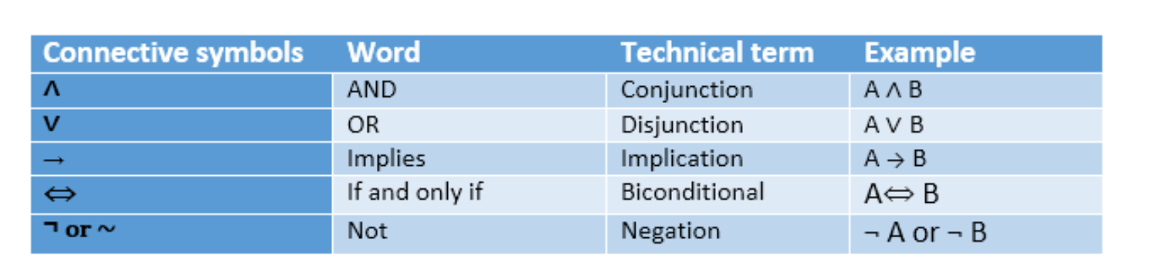
Following is the summarized table for Propositional Logic Connectives:

Slide 18
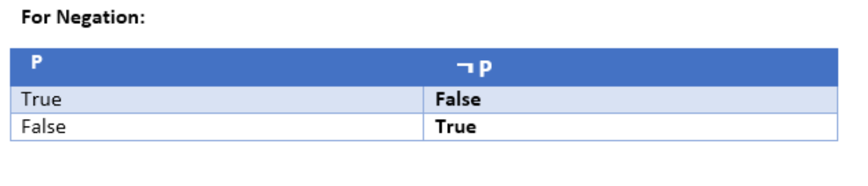
Negation

Slide 19
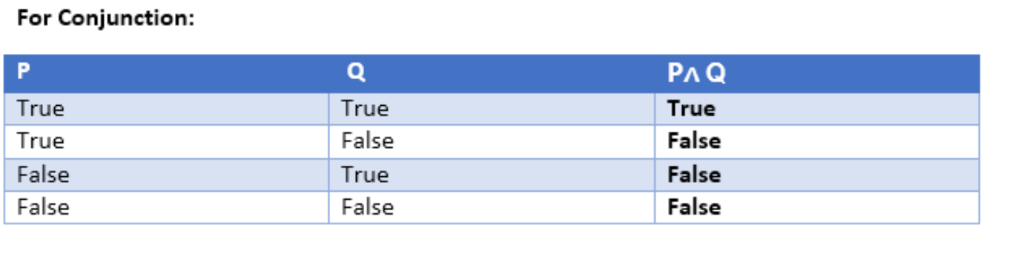
Conjuntion

Slide 20
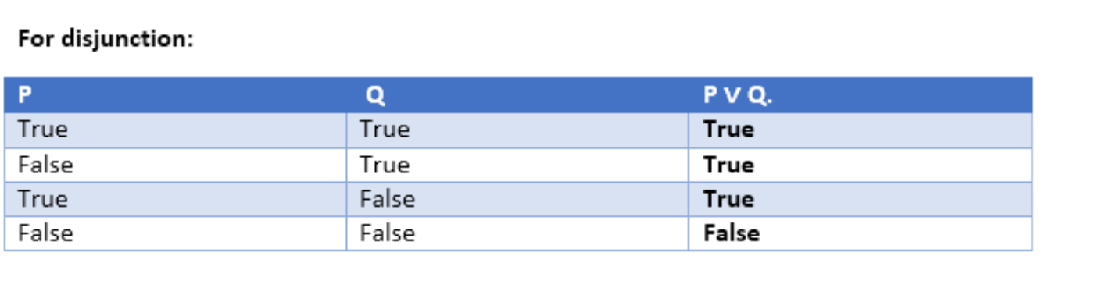
Disjunction

Slide 21
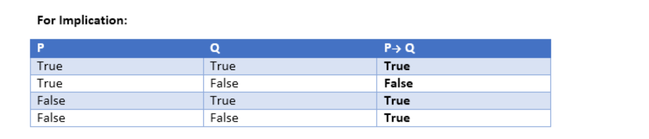
Implication

Slide 22
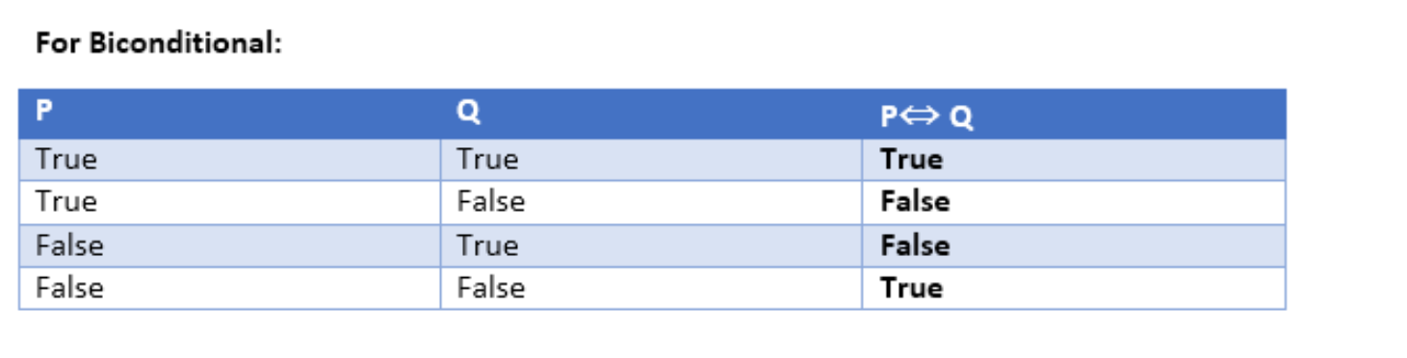
Biconditional

Slide 23
Wumpus world:
The Wumpus world is a simple world example to illustrate the worth of a knowledge-based agent and to represent knowledge representation.

